Slide 1
4
INTEGRALS
Copyright © Cengage Learning. All rights reserved.

Slide 2
4.9
Improper Integrals
Copyright © Cengage Learning. All rights reserved.

Slide 3

Improper Integrals
In defining a definite integral we dealt with a function f defined on a finite interval [a, b].
In this section we extend the concept of a definite integral to the case where the interval is infinite and also to the case where f has an infinite discontinuity in [a, b].
In either case the integral is called an improper integral.

Slide 4
Type 1: Infinite Intervals

Slide 5
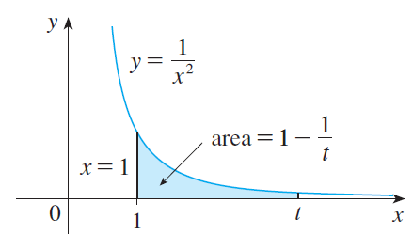
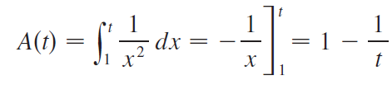
Type 1: Infinite Intervals
Consider the infinite region S that lies under the curve
y = 1/x², above the x-axis, and to the right of the line x = 1.
The area of the part of S that
lies to the left of the line x = t
(shaded in Figure 1) is
Figure 1

Slide 6
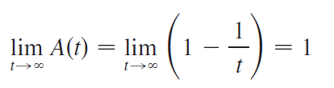
Type 1: Infinite Intervals
Notice that A(t) < 1 no matter how large t is chosen.
We also observe that

Slide 7

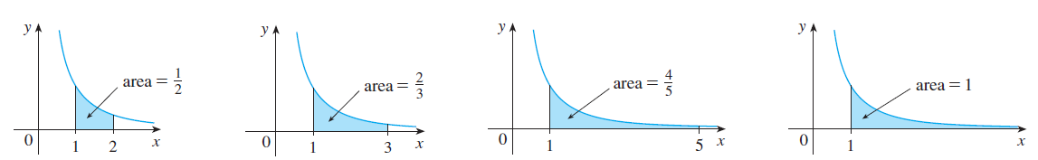

Type 1: Infinite Intervals
The area of the shaded region approaches 1 as t →
(see Figure 2),
so we say that the area of the infinite region S is equal to 1 and we write
Figure 2

Slide 8
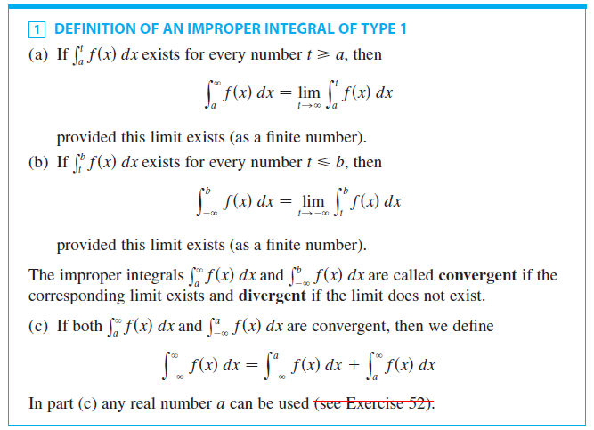
Type 1: Infinite Intervals
Using this example as a guide, we define the integral of f (not necessarily a positive function) over an infinite interval as the limit of integrals over finite intervals.

Slide 9



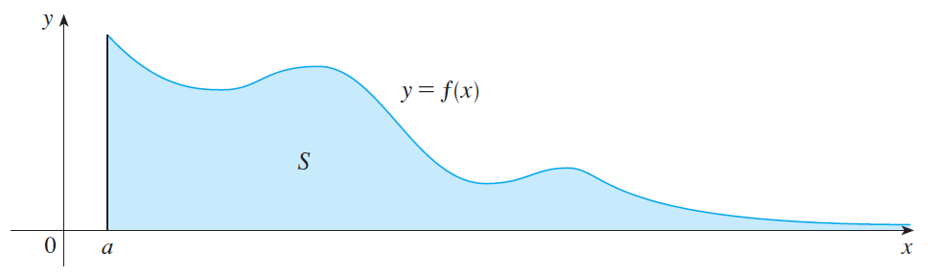
Type 1: Infinite Intervals
Any of the improper integrals in Definition 1 can be interpreted as an area provided that f is a positive function.
For instance, in case (a) if f (x) ≥ 0 and the integral is convergent, then we define the area of the region
in Figure 3 to be
Figure 3

Slide 10

Type 1: Infinite Intervals
This is appropriate because is the limit as t → of the area under the graph of f from a to t.

Slide 11



Example 1
Determine whether the integral is convergent or divergent.
Solution:
According to part (a) of Definition 1, we have

Slide 12

Example 1 – Solution
cont’d
The limit does not exist as a finite number and so the improper integral is divergent.

Slide 13

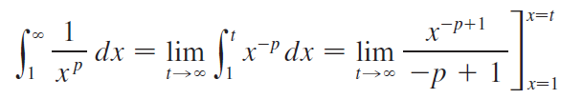
Example 4
For what values of p is the following integral convergent?
Solution:
We know from Example 1 that if p = 1, then the integral is divergent, so let’s assume that p ≠ 1.
Then

Slide 14
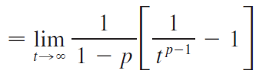

Example 4 – Solution
cont’d
If p > 1, then p – 1 > 0, so as t → , t ^{p – 1} → and
1/t ^{p – 1} → 0.
Therefore
and so the integral converges.

Slide 15
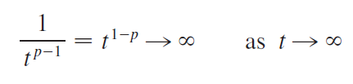
Example 4 – Solution
cont’d
But if p < 1, then p – 1 < 0 and so
and the integral diverges.

Slide 16

Type 1: Infinite Intervals
We summarize the result of Example 4 for future reference:

Slide 17
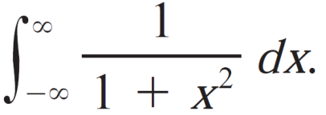
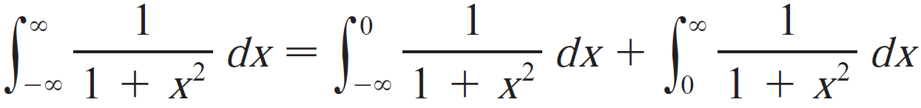
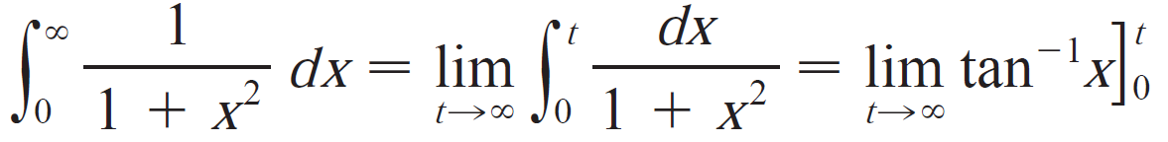
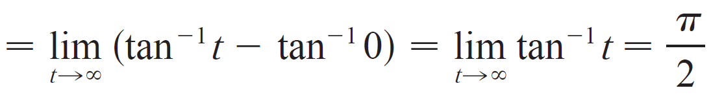
Example 3
Evaluate
Solution:
It is convenient to choose a=0 in Definition 1(c):
We must now evaluate the integrals on the right side separately:

Slide 18
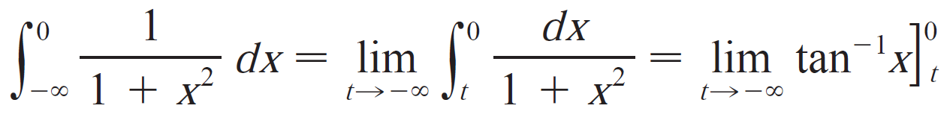
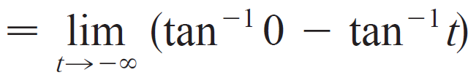
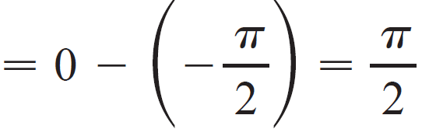
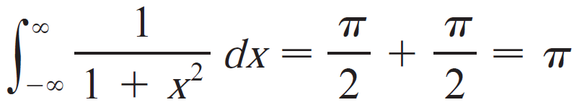
Example 3 – Solution
cont’d
Since both of these integrals are convergent, the given integral is convergent and

Slide 19


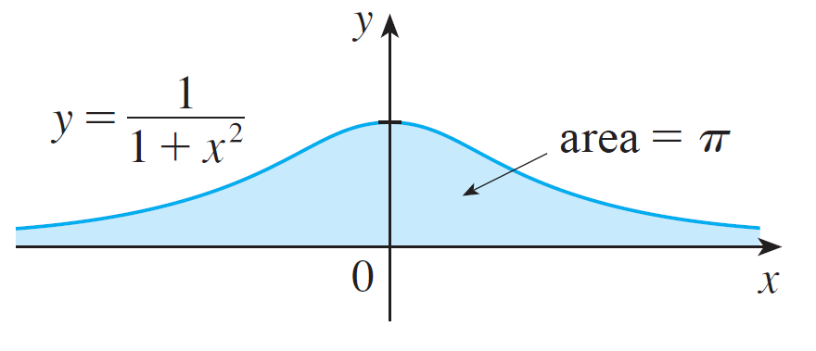
Example 3 – Solution
cont’d
Since the given improper integral can be interpreted as the area of the infinite region that lies under the curve and above the x-axis.

Slide 20
Type 2: Discontinuous Integrands

Slide 21
Type 2: Discontinuous Integrands
Suppose that f is a positive continuous function defined on a finite interval [a, b) but has a vertical asymptote at b.
Let S be the unbounded region under the graph of f and above the x-axis between a and b.
(For Type 1 integrals, the regions extended indefinitely in a horizontal direction. Here the region is infinite in a vertical direction.)

Slide 22

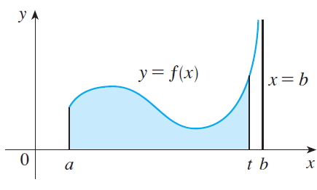
Type 2: Discontinuous Integrands
The area of the part of S between a and t (the shaded region in Figure 7) is
Figure 7

Slide 23

Type 2: Discontinuous Integrands
If it happens that A(t) approaches a definite number A as
t → b–, then we say that the area of the region S is A and we write
We use this equation to define an improper integral of Type 2 even when f is not a positive function, no matter what type of discontinuity f has at b.

Slide 24
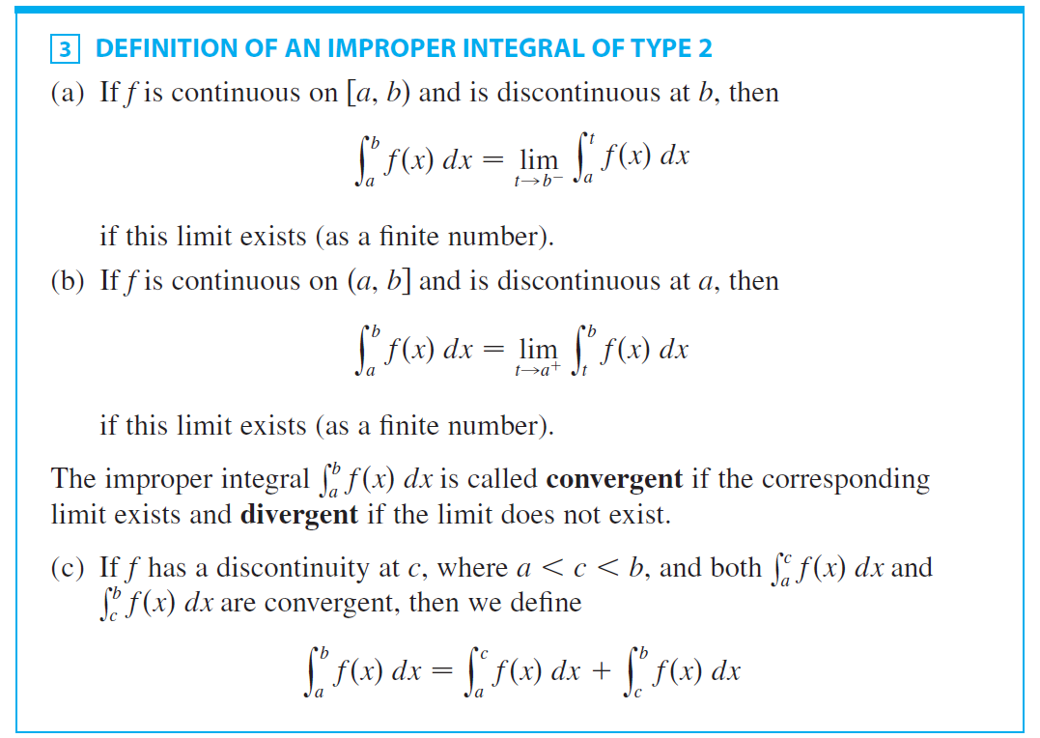
Type 2: Discontinuous Integrands

Slide 25



Example 5
Find
Solution:
We note first that the given integral is improper because
has the vertical asymptote x = 2.
Since the infinite discontinuity occurs at the left endpoint of [2, 5], we use part (b) of Definition 3:

Slide 26

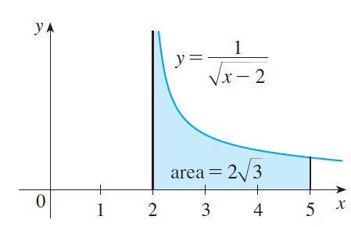
Example 5 – Solution
cont’d
Thus the given improper integral
is convergent and, since the
integrand is positive, we can
interpret the value of the
integral as the area of the
shaded region in Figure 10.
Figure 10

Slide 27
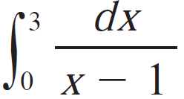
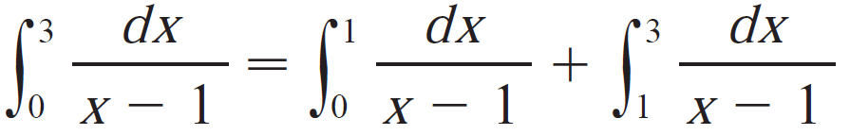
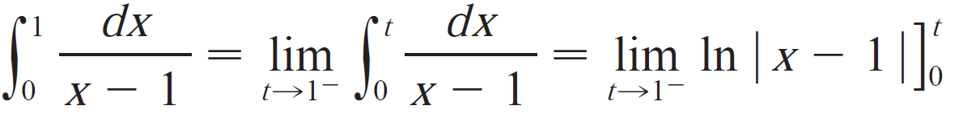
Example 7
Evaluate if possible.
Solution:
Observe that the line x=1 is a vertical asymptote of the integrand. Since it occurs in the middle of the interval [0,3], we must use part (c) of Definition 3 with c=1:
where

Slide 28
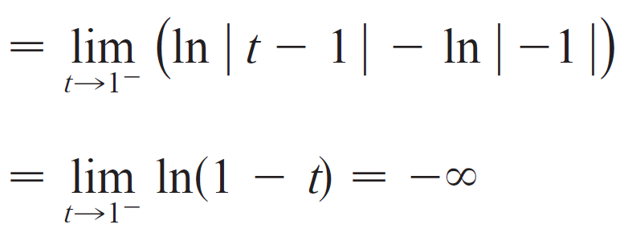

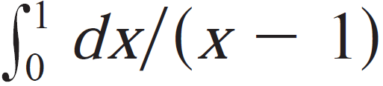


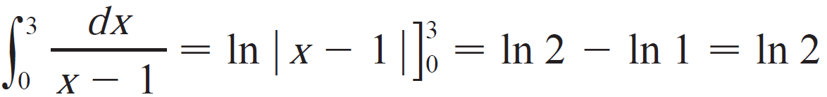
Example 7 – Solution
cont’d
Because Thus is divergent.
This implies that is divergent.
We do not need to evaluate
Warning: If we had not noticed the asymptote x=1 and instead confused the integral with an ordinary integral, we may had a erroneous calculation:

Slide 29
Example 7 – Solution
cont’d
Warning: If we had not noticed the asymptote x=1 and instead confused the integral with an ordinary integral, we may had a erroneous calculation:
This is wrong because the integral is improper and must be calculated in terms of limits.

Slide 30
A Comparison Test for
Improper Integrals

Slide 31
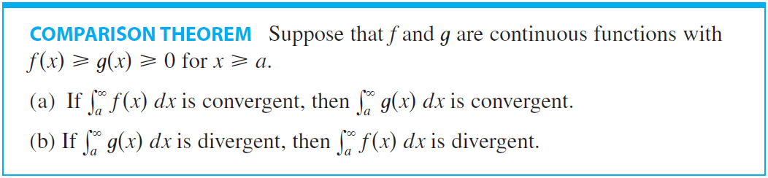
A Comparison Test for Improper Integrals
Sometimes it is impossible to find the exact value of an improper integral and yet it is important to know whether it is convergent or divergent. In such cases the following theorem is useful.

Slide 32



Example 8
Show that is convergent.
Solution:
We can’t evaluate the integral directly because the antiderivative of is not an elementary function.
We write
and observe that the first integral on the right-hand side is just an ordinary definite integral.

Slide 33
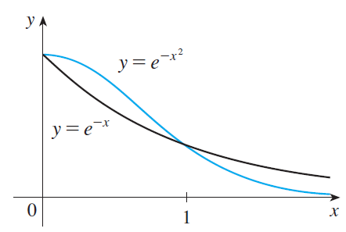
Example 8 – Solution
cont’d
In the second integral we use the fact that for x ≥ 1 we have x² ≥ x, so –x² ≤ –x and therefore e^{–x2} ≤ e^{–x}. (See Figure 12.)
Figure 12

Slide 34



Example 8 – Solution
cont’d
The integral of e^{–x} is easy to evaluate:
Thus, taking f (x) = e^{–x} and g(x) = e^{–x2} in the Comparison Theorem, we see that is convergent.
It follows that is convergent.

